Slide 1
OXYGEN CONSERVING DEVICE
TEAM NAME: LITTLE TECHIES
MADHUMITHA G
SUBITSHA V
Department of Biomedical Engineering Bannari Amman Institute of Technology

Slide 2
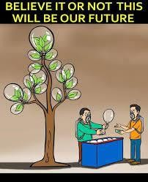
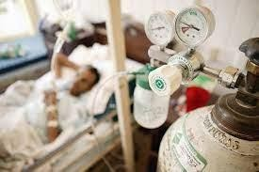
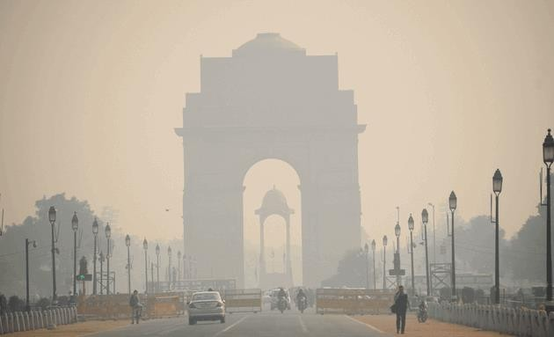
PROBLEM STATEMENT
.

Slide 3
ABSTRACT
Supplemental oxygen is often given to awake, sedated patients in order to decrease the frequency and depth of oxygen desaturation caused by periods of respiratory depression and airway obstruction. Oxygen delivered during patient exhalation is mostly vented to the air and wasted, providing an opportunity for oxygen conservation by shutting the flow when the patient is exhaling. This oxygen can be conserved by closing the valve of oxygen supply during exhalation and opening it during inhalation. By implementing this, we can overcome the oxygen demand. Here we describe a simple, open source, and rapidly manufacturable oxygen conservation device for use with dual-port nasal cannula that can extend the life of current oxygen supply by almost two to three times, which we hope will help towards coping with the ongoing crisis like covid-19.

Slide 4
INTRODUCTION
Oxygen delivered during patient exhalation is usually vented to the atmospheric air and wasted.
Our project aims at providing a chance for oxygen conservation by shutting the flow when the
patient is exhaling.
This oxygen may be conserved by closing the valve of oxygen supply during exhalation and opening it during inhalation.
Statistically, the count of oxygen consuming patients per cylinder will be increased 2-3 times.
“Pennies make Pounds”

Slide 5
METHODOLOGY PROPOSED
The partial pressure of oxygen in atmospheric air is higher in environment than in alveoli during inhalation & vice versa during exhalation.
This difference in partial pressure is sensed using differential pressure sensor.
Oxygen delivery is turned off during active exhalation & turned on during early inspiration
and pause phase.

Slide 6
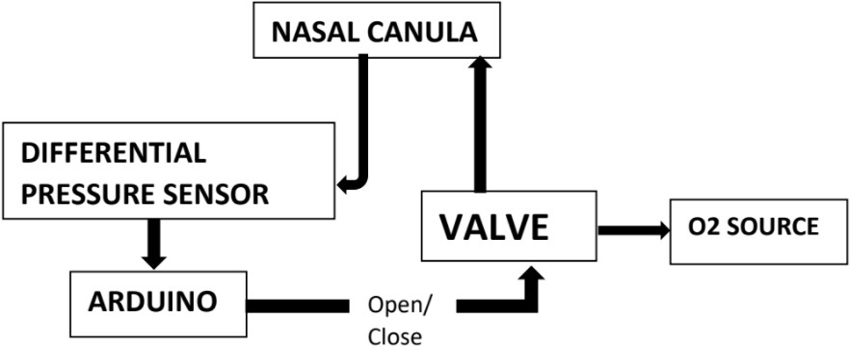
BLOCK DIAGRAM
.

Slide 7
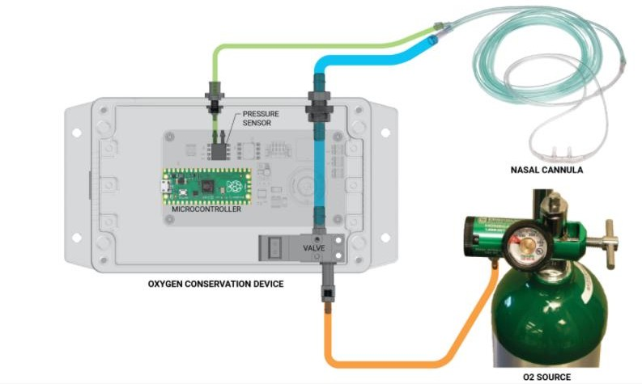
RESULTS AND DISCUSSION
Simplified schematic and piping diagram of the proposed device

Slide 8
ADDED FEATURES
Respiratory parameters
Display of trend
Bluetooth interface with SpO2 sensor for alarms, device hub for remote Monitoring

Slide 9
FUTURE SCOPE/RECOMMENDATIONS
Rapidly manufactured
Connect with clinicians and reputed manufacturers
Bring solutions to support oxygen delivery and conservation efforts

Slide 10
CONCLUSION
Recently we have undergone and still undergoing corona pandemic situation where the demand for oxygen is high, by implementing our project idea we can overcome these situations by conserving oxygen.
Here the patient will be delivered with required amount of oxygen alone.

Slide 11
REFERENCES
https://www.medrxiv.org/content/10.1101/2021.05.19.21257477v1.full
https://digitalcommons.usu.edu/cgi/viewcontent.cgi?referer=https://www.google.com/&httpsredir
=1&article=1433&context=spacegrant

